Slide 1
LAUSD VIQRC League Orientation
Review the League Posting While You Wait:
Navigate to www.RobotEvents.com in your browser
  Login not needed until event registration
Click on Competitions and select VEX IQ Robotics Competition
Type “LAUSD” into Event Name field and click Filter button
Click on the Name of the League you would like to attend
Scroll down to read the General Info tab
Click on and read the Agenda tab and the Volunteer tab
Let us know if you see any errors or have any questions

Slide 2

Coach Orientation Meeting
LAUSD East Boyle Heights STEM League
LAUSD East Del Olmo League
LAUSD East MaCES League
LAUSD East Main Street League
LAUSD East South Gate League
LAUSD East Virgil League
Contact Information
Kearstie Hernandez - Region East STEAM Coordinator (Kearstie.Hernandez@lausd.net)
LeRoy Nelson - Sponsor (LeRoy@larobotics.org)
Notes:
Kearstie - intro

Slide 3
LAUSD East VEX IQ League Hosts
League Host School | Principal | Event Partner
Boyle Heights STEM Academy | Matt Mihm | Israel Hernandez
Frank Del Olmo Elementary School | Rania Nahle | Jose Aragon
Main Street Elementary School | Eva Rodriguez-Chavez | Moises Valentin
Maywood Center for Enriched Studies | Gabriel Duran | Agustin Sarmiento
South Gate High School | Leo Gonzalez | Rowland Santos
Virgil Middle School | Andrew Conroy | Hector Cervantes
Notes:
Kearstie - intro

Slide 4
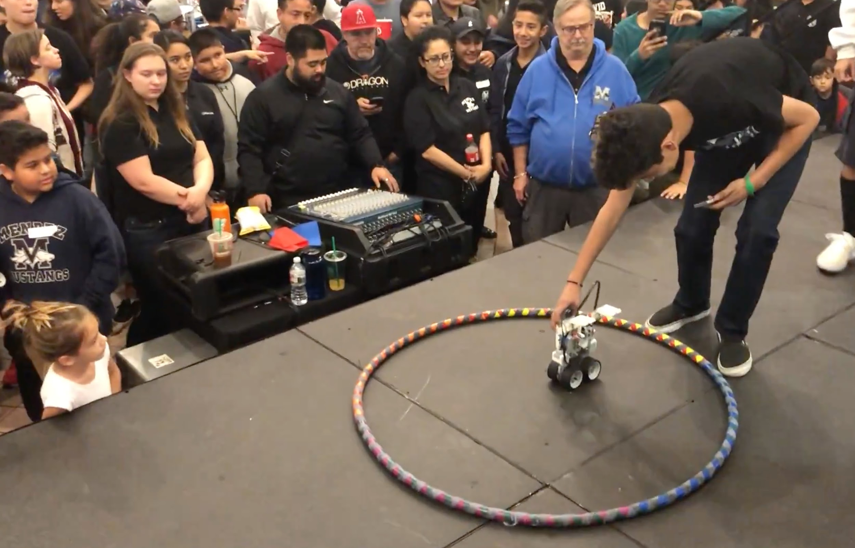
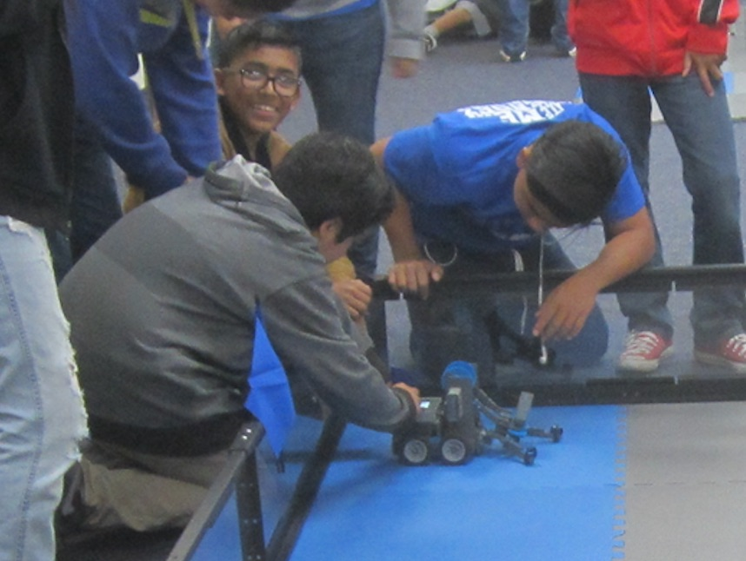
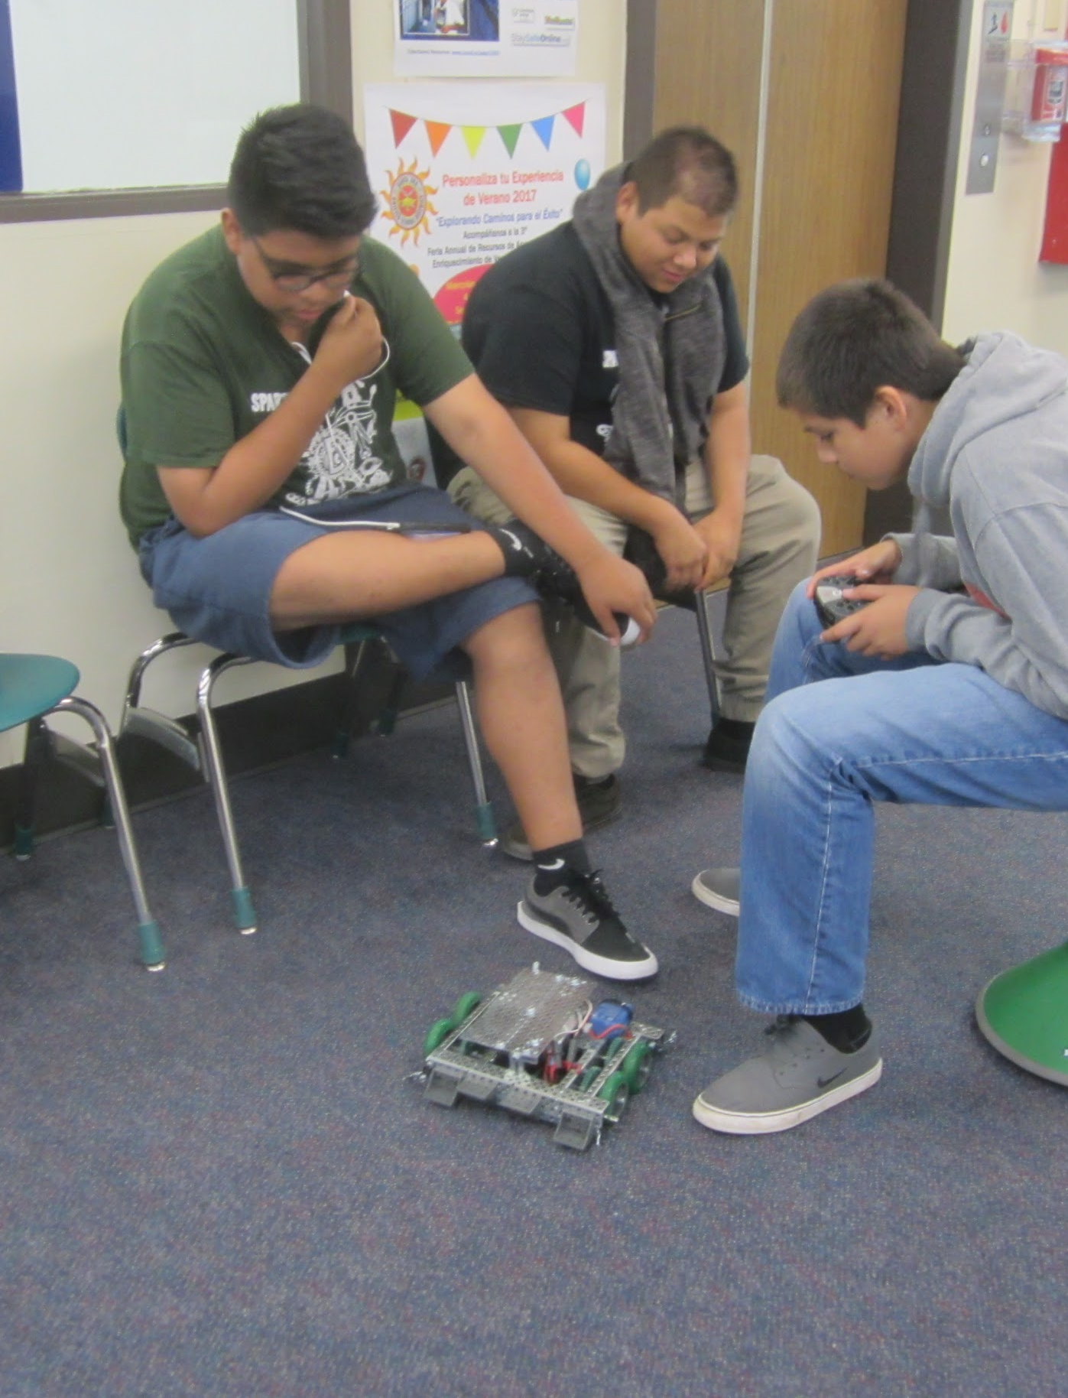
Why Robotics Competitions? Critical Thinking, Communication, Collaboration, Creativity
Notes:
Kearstie -
Let’s start with why we do robotics. 4 Cs. 21st Century Skill Set. Preparing students for future opportunities and careers.

Slide 5
Value of Competitions
“Competition and team activities can drive learning and performance better than solo endeavors.”
Top Dog: The Science of Winning and Losing, by Bronson
Educational competitions provide engaging, long-term experiences that inspire and motivate students, educators, and entire communities. They provide professional development opportunities for educators, volunteer activities for community or industry members, and real-world connections for the students involved.
Notes:
Kearstie - read slide

Slide 6
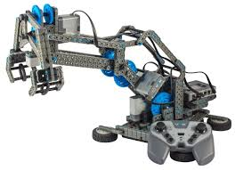
What is VEX IQ Robotics?
VEX IQ is a robotics platform designed to transform STEM learning for students and their teachers.
Robotics brings real-world problems for students to engineer solutions

Slide 7
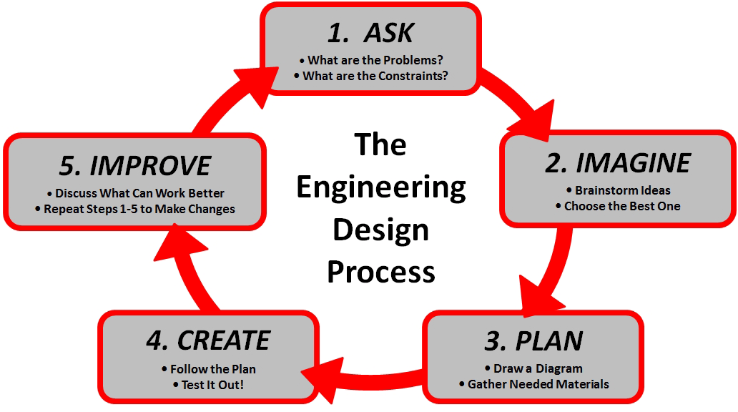
Students Learn and Practice the
Engineering Design Process
Notes:
Kearstie - read slide

Slide 8

VEX IQ Robotics Competition MIX & MATCH
Video (5 min) https://www.youtube.com/embed/RN-UyJbe_yg
Notes:
Kearstie - play video

Slide 9
Fifteen LAUSD VIQRC Leagues
Region | Grade Levels | Capacity | League Host School Name
East | ES | 36 | Eastside STEM Magnet HS (Boyle Hts)
East | ES | 24 | Main Street Elementary School
East | ES/MS | 36 | Maywood Center for Enriched Studies
East | ES | 24 | South Gate High School
East | ES/MS | 24 | Virgil Middle School
North | ES | 36 | Chatsworth Charter High School
North | MS | 36 | Chatsworth Charter High School
North | ES | 24 | Montague Charter Academy
North | ES | 24 | Mulholland Middle School
North | ES | 24 | Nobel Charter Middle School
South | ES/MS | 24 | Augustus F Hawkins High School
South | ES/MS | 24 | Rudecinda S Dodson Middle School
South | ES | 24 | Stephen M White Middle School
West | ES/MS | 24 | Fairfax High School
West | ES/MS | 24 | Orville Wright Middle School

Slide 10
LAUSD East VIQRC League Schedules http://larobotics.org/NTGLeagues.html
League Host School Name | Times | League Orientation | League Session Dates
 |  |  | Qual. 1 | Qual. 2 | Qual. 3 | Champ.
Boyle Heights STEM Academy | 4-7pm |  | Fri 10/25/24 | Fri 11/15/24 | Fri 12/13/24 | Fri 01/31/25
Frank Del Olmo Elementary School | 4-7pm | Fri 10/04/24 | Mon 10/07/24 | Mon 10/28/24 | Mon 12/02/24 | Mon 02/03/25
Main Street Elementary School | 4-7pm |  | Wed 10/09/24 | Wed 11/13/24 | Wed 12/11/24 | Wed 01/29/25
Maywood Center for Enriched Studies | 4-7pm |  | Fri 10/18/24 | Fri 11/01/24 | Fri 12/06/24 | Fri 01/17/25
South Gate High School | 4-7pm |  | Wed 10/16/24 | Wed 11/06/24 | Wed 12/04/24 | Wed 01/22/25
Virgil Middle School | 4-7pm | Fri 10/11/24 | Mon 10/21/24 | Mon 11/18/24 | Mon 12/09/24 | Mon 01/27/25

Slide 11
LAUSD South VIQRC League Schedules http://larobotics.org/NTGLeagues.html
League Host School Name | Times | League Orientation | League Session Dates
 |  |  | Qual. 1 | Qual. 2 | Qual. 3 | Champ.
Augustus F Hawkins High School | 4-7pm | Mon 10/06/25 | Mon 10/27/25 | Mon 11/17/25 | Mon 12/15/25 | Mon 02/09/26
Rudecinda S Dodson Middle School | 4-7pm |  | Wed 10/29/25 | Wed 11/19/25 | Wed 12/17/25 | Wed 02/04/26
Stephen M White Middle School | 4-7pm |  | Wed 10/22/25 | Wed 11/12/25 | Wed 12/10/25 | Wed 01/21/26

Slide 12
League Sessions
The first Qualifying session begins with Team Check-in and Robot Inspection. At Check-in, teams verify release forms, turn in checks (if not paid), and sign up to provide one volunteer for at least one league session if they did not do so at Orientation. One optional Teamwork Challenge Practice Match for each team will be followed by three for four Teamwork Challenge Qualifying Matches.
The next two Qualifying sessions begin with Check-in and Robot Inspection, followed by four Teamwork Challenge Qualifying Matches.
The final Championship session begins with Check-in and Robot Inspection, followed by Robot Skills Challenge Matches and Judging follow-up Interviews, followed by Teamwork Challenge Finals Matches and Awards.
Teams need to check in and robots need to pass inspection by deadlines to be included in the Teamwork Challenge match schedule.

Slide 13
Agenda for League Events
3 Qualifying Sessions | Final Championship Session
3:30-4:00 PM Doors open. Set up | 3:30-4:00 PM Doors open. Set up
3:30-3:45 PM Volunteers check in | 3:30-3:45 PM Volunteers check in
4:00-4:30 PM Teams check in | 4:00-4:30 PM Teams check in
4:00-4:45 PM Robot Inspection | 4:00-4:45 PM Robot Inspection
4:45-5:00 PM Opening Ceremony / Event Meeting / Announcements | 4:45-5:00 PM Opening Ceremony / Event Meeting / Announcements
5:00-7:00 PM Teamwork Practice and Qualifying Matches | 4:15-7:00 PM Robot Skills Matches and Judging
7:00-7:30 PM Teams depart / Tear down / Doors close | 7:00-7:45 PM Teamwork Finals Matches and Awards
 | 7:45-8:15 PM Teams depart / Tear down / Doors close
Notes:
Kearstie - go over slide

Slide 14
Volunteers (for leagues with 24 or 36 teams)
Leagues need at least 6 or 8 trained volunteers that can attend all sessions
  1-2 or 2-3 Robot Inspectors, Queue Crew (one adult, others can be students)
  1-2 or 1-3 Head Referees (certified, age 16+), 2 or 3 Scorekeeper Referees (age 15+)
  1-2 Emcees, 1 VEX TM Computer Operator
Each team is asked to provide one volunteer for at least one session:
  1-2 or 2-3 Check-in, Queue Crew (one adult, others can be students)
  1-2 or 2-3 Field Reset (students)
  1-2 Practice Field Official (one adult, second can be student)
  6-9 or 9-12 Remote Judges (adults, before Championship Session only)
  3-6 In-person Judges (adults, Championship Session only)
Schedule volunteers at League Orientation or at first league session.
A brief overview of the volunteer roles is available online at:
https://kb.roboticseducation.org/hc/en-us/articles/4969327789207-Volunteer-Roles-Available

Slide 15
VEX Participant Release Forms
VEX Participant Release Forms are required for all team members
  Student forms are signed/submitted by parents or guardians
  Coaches, Mentors, and Parent Volunteers need forms for each team
  Audience members do not need forms
  Available in English and Spanish
  Are good all season for one team number and program
Instructions for online and paper forms are in REC Library
  https://viqrc-kb.recf.org/hc/en-us/articles/9778547067159-Participant-Release-Form
Online forms
  Coaches can get links for Pre-filled forms for each team at RobotEvents.com / My Account
Paper forms
  Team Contacts can download PDFs to print for parents and scan signed forms and upload at RobotEvents.com / My Account

Slide 16

Field Trips
https://achieve.lausd.net/Page/15087
Notes:
LAUSD ifieldtrip
https://achieve.lausd.net/Page/15087

Slide 17
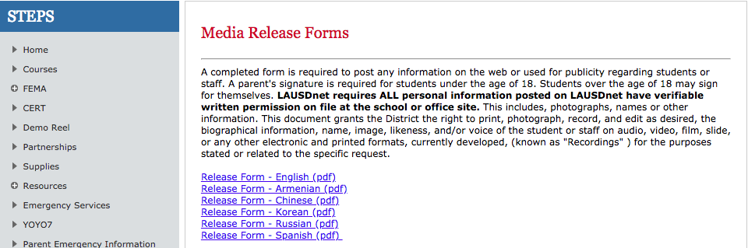
Media Release Form
https://achieve.lausd.net/Page/2794
Notes:
Print, make a copy, keep it for your records, and give me a copy. I need to have all of LAUSD Media Release Forms.

Slide 18
Register Your Team For The League
Log into www.RobotEvents.com in your browser
Click on Competitions and select VEX IQ Robotics Competition
Type LAUSD into Event Name field and click Filter button
Click on the Name of the League that you want to attend
Click on Waitlist (new, easier process for Invitational events)
Add your Team Number(s)
When an Event Administrator moves your team(s) to Registered Teams, your team(s) will be Registered and Unpaid

Slide 19

Q & A
Then LeRoy will provide guidance for new coaches.

Slide 20
Region East Robotics Contact Information
Kearstie Hernandez
STEAM Coordinator
LAUSD Region East
Kearstie.Hernandez@lausd.net
LeRoy Nelson
Team and Event Sponsor
Los Angeles Robotics
LeRoy@larobotics.org
310-529-4637

Slide 21
Region South Robotics Contact Information
Kristine Tserunyan
STEAM Coordinator
LAUSD Region South
kxt46712@lausd.net
LeRoy Nelson
Team and Event Sponsor
Los Angeles Robotics
LeRoy@larobotics.org
310-529-4637

